Slide 1



SuperStore_Report
View in Power BI
Last data refresh:
3/12/2023 12:41:06 PM UTC
Downloaded at:
3/12/2023 2:37:31 PM UTC

Slide 2
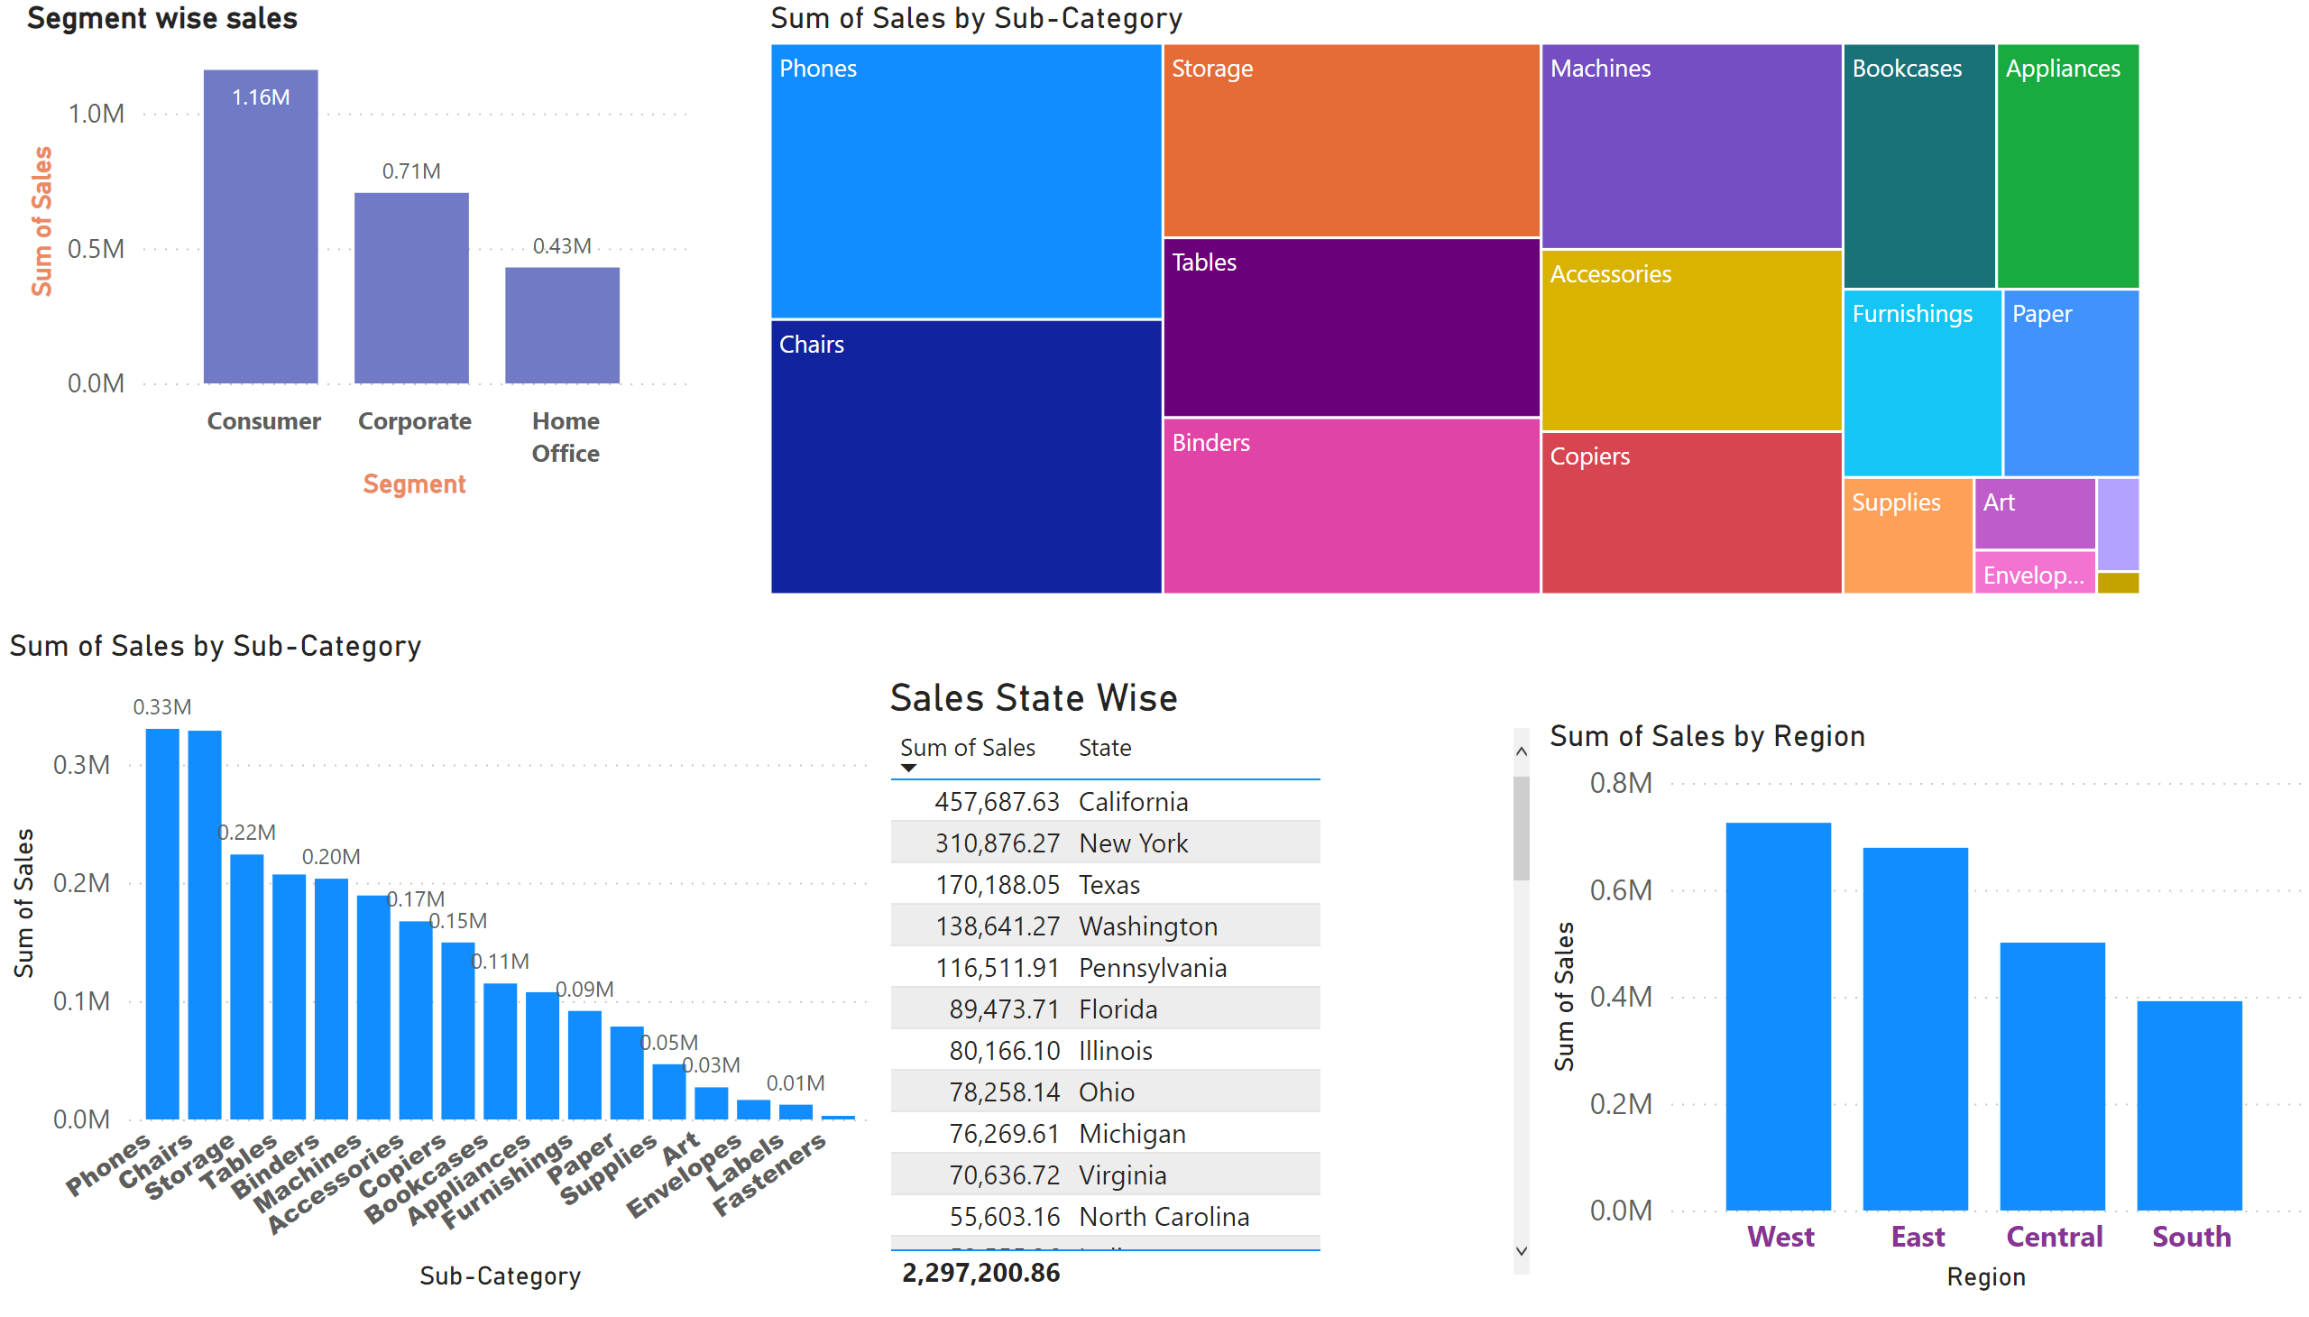
Sales_Overview
Notes:
Segment wise sales
No alt text provided
treemap
No alt text provided
clusteredColumnChart
No alt text provided
Sales State Wise
No alt text provided
columnChart
No alt text provided

Slide 3
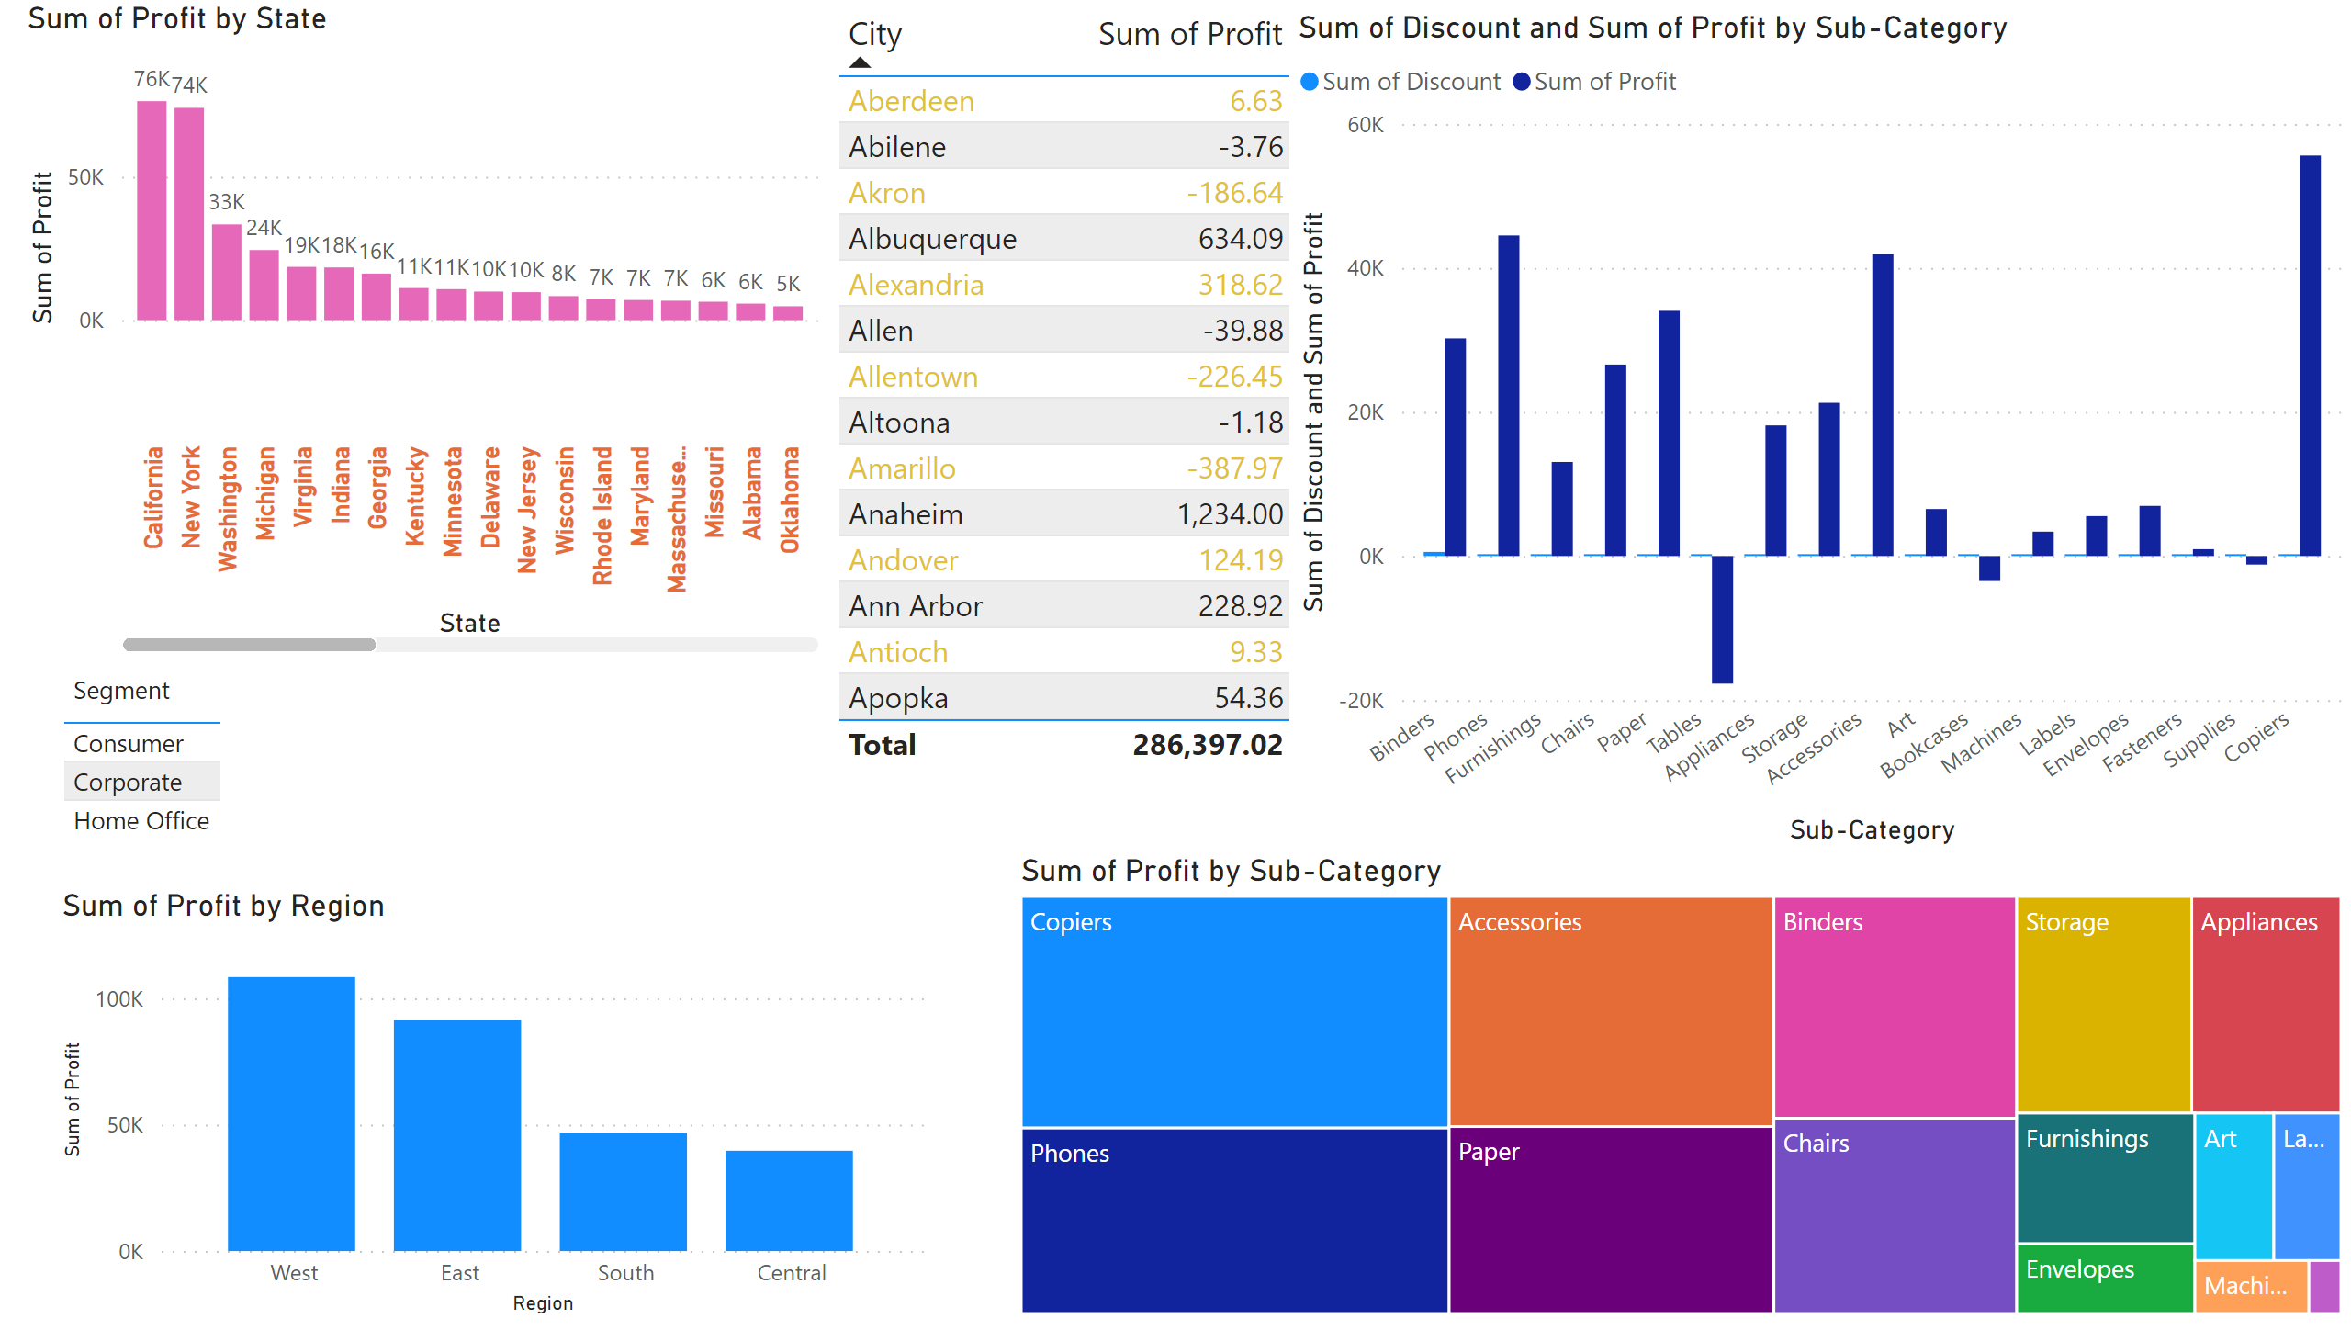
Profit_Overview
Notes:
clusteredColumnChart
No alt text provided
columnChart
No alt text provided
treemap
No alt text provided
tableEx
No alt text provided
tableEx
No alt text provided
clusteredColumnChart
No alt text provided

Slide 4
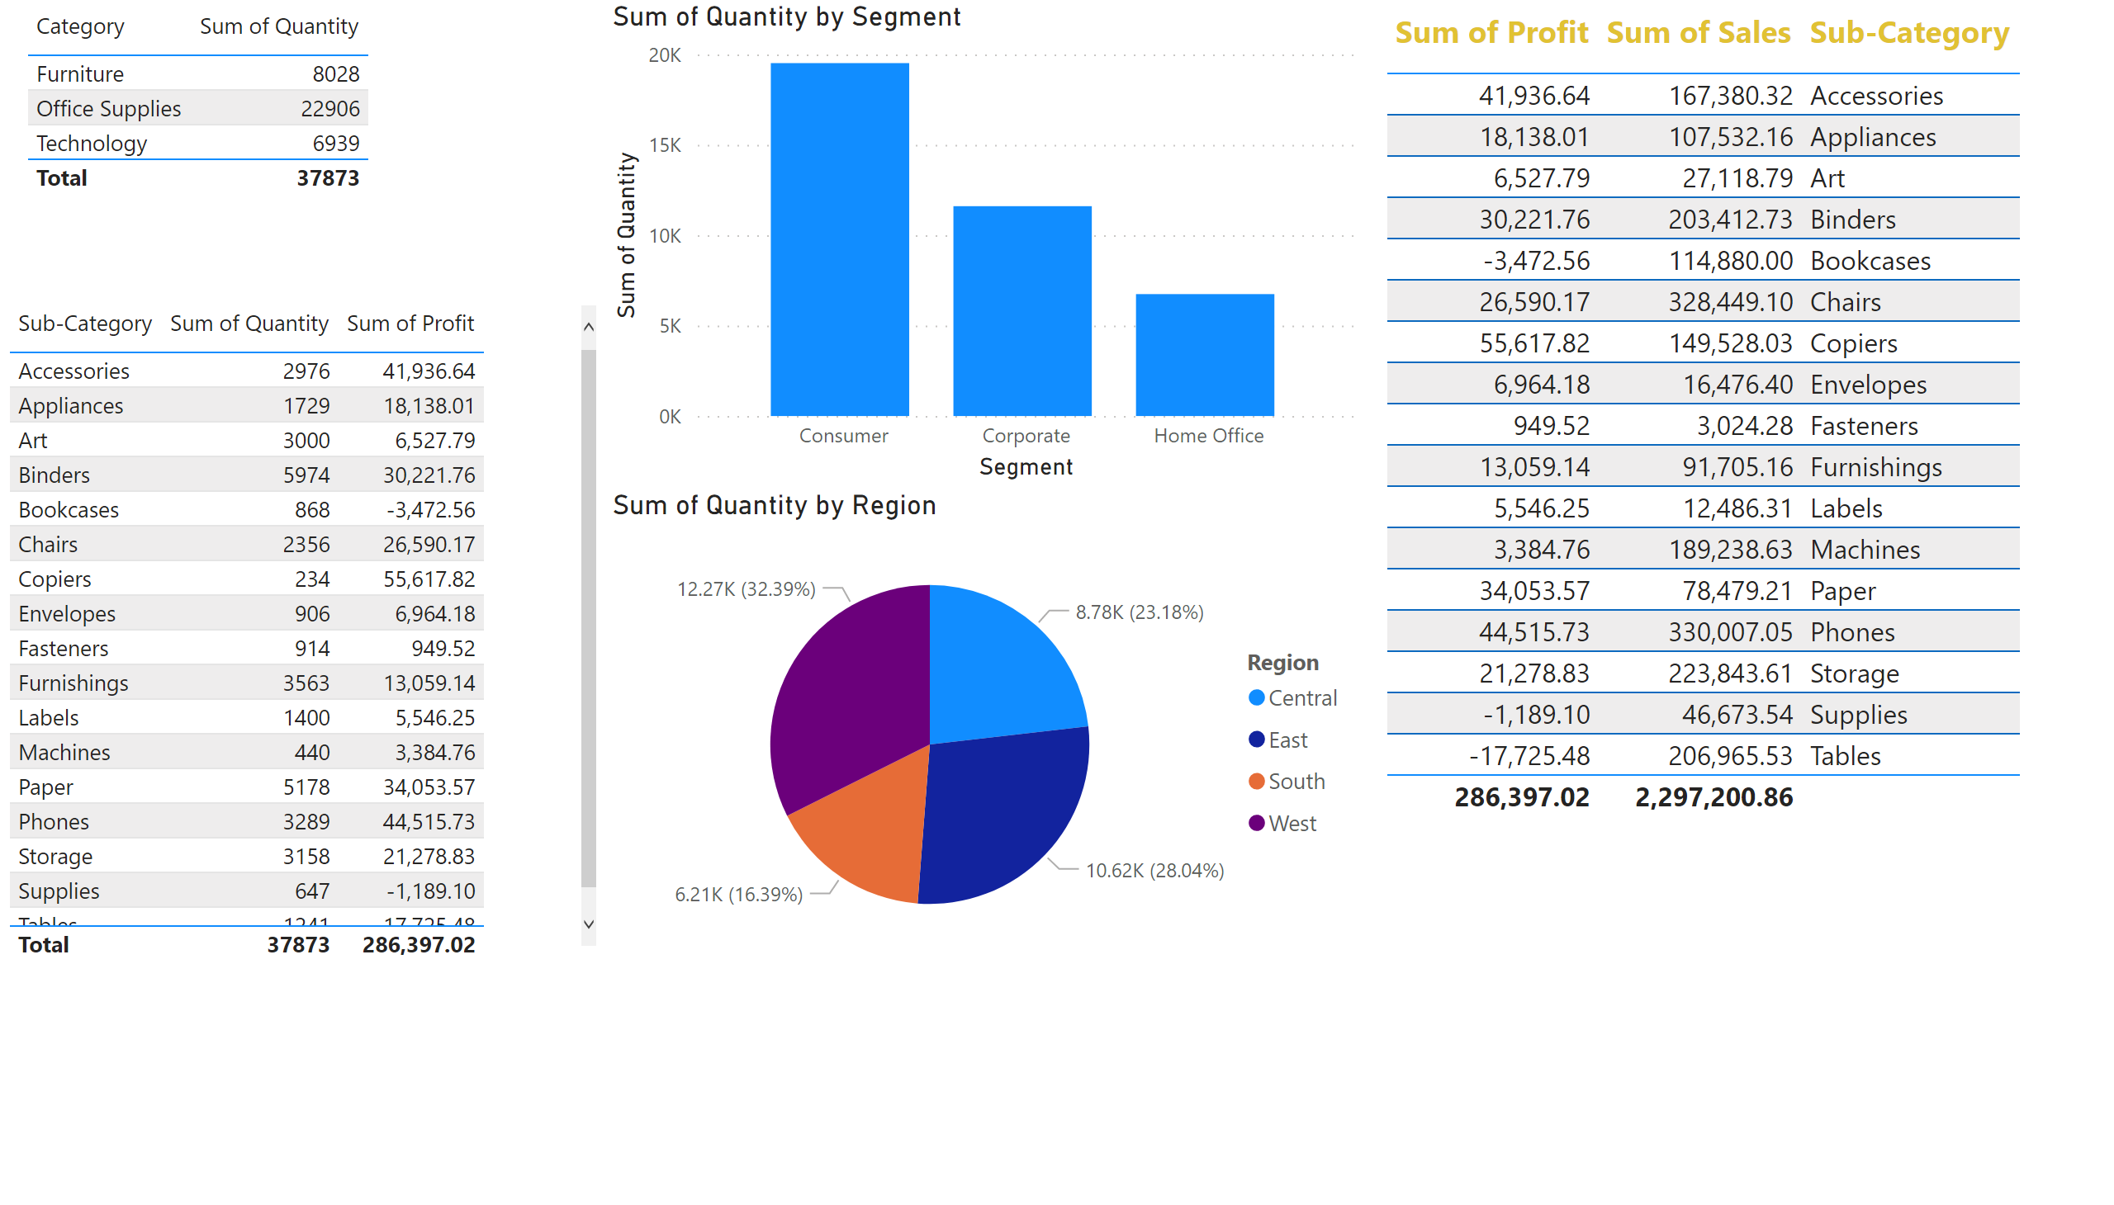
Quantity_based_overview
Notes:
tableEx
No alt text provided
pieChart
No alt text provided
clusteredColumnChart
No alt text provided
tableEx
No alt text provided
tableEx
No alt text provided

